Slide 1
BLOOD DONAR ANDROID APPLICATION
PRESENTATION

Slide 2
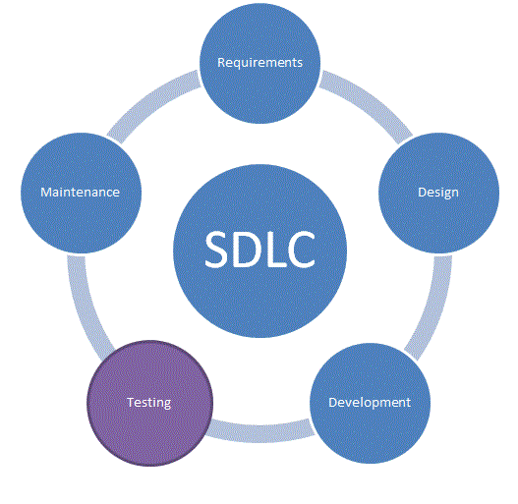
Software Development Life Cycle (SDLC)

Slide 3
SDLC
The software development life cycle (SDLC) is a framework defining tasks performed at each step in the software development process. It is a process used by software industry to design, develop and test high quality softwares. The SDLC aims to produce a high quality software that meets or exceeds customer expectations, reaches completion within times and cost estimates. The life cycle defines a methodology for improving the quality of software and the overall development process. A systems development life cycle is composed of a number of clearly defined and distinct work phases which are used by systems engineers and systems developers to plan for, design, build, test, and deliver information systems. Like anything that is manufactured on an assembly line, an SDLC aims to produce high quality systems that meet or exceed customer expectations, based on customer requirements, by delivering systems which move through each clearly defined phase, within scheduled time-frames and cost estimates.

Slide 4
Analysis
System Analysis
System analysis refers to the process of examining a business situation with the intent of improving it through better procedures and methods. It is the process of gathering and interpreting facts, diagnosing problems and using tile information to recommend improvement to the system. In brief, we can say that analysis specifies what the system should do. Itis a problem solving technique that decomposes a system into its component pieces for the purpose of the studying how well those component parts work and interact to accomplish their purpose. System analysis is the process of studying the business processors and procedures, generally referred to as business systems, to see how they can operate and whether improvement is needed. This may involve examining data movement and storage, machines and technology used in the system, programs that control the machines, people providing inputs, doing the processing and receiving the outputs.
System Analysis is the detailed study conducted with the purpose of wanting to fully understand the existing system and to identify the basic information requirements.System Analysis is done in every effected aspect to determine whether the purposed system is feasible enough to be implemented. This is called the fact-finding stage. Key security activities for system analysis include:
Conduct the risk assessment and use the results to supplement the baseline security controls
Analyze security requirements
Perform functional and security testing
Prepare initial documents for system certification and accreditation

Slide 5
Technical Analysis
In Technical Analysis we have analyzed that whether the system can run such type of application. In BTES Training app we require a hardware which can run android operating system to launch the application, and to develop this project we require eclipse and an android phone so that we can check the output of the code. During technical analysis, the technical merits of the system are studied and at the same time collecting additional information about performance, reliability, maintainability and predictability. Technical analysis begins with an assessment of the technical viability of the proposed system. As the software is very much economically feasible, then it is really important for it to be technically sound.
Feasibility Study
In feasibility study we checked that this project is feasible or not. How much it will cost to developer as well as the client. On developer side we checked that it don’t require any expensive tool to develop such application, and on customer side we also analyzed that it don’t require any expensive device to launch this application.
An initial investigation culminates in a proposal that determine whether an alternative system is feasible. A personal summarizing the thinking of the analyst is presented to the user for review. When approved, the personal initiates a feasibility study that describes and evaluates candidate system and provide for selection of the best system that meets the performance requirements.
Economic Feasibility:
How much it will cost to developer as well as the client. On developer side we checked that it don’t require any expensive tool to develop such application, and on customer side we also analyzed that it don’t require any expensive device to launch this application. Economic analysis is most frequently used for evaluating the effectiveness of a newly build system, more commonly known as cost/benefit analysis.
.

Slide 6
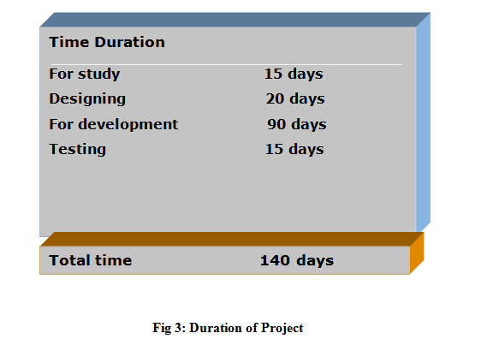
Technical Feasibility
For this application the Minimum hardware requirement is 1GB. It require Pentium processor IV processor or higher, Minimum space on disk is 512MB, Minimum space to execute the application is 6.0 MB. Software requirements to develop the application is Operating system Windows 7 or higher and Front End Eclipse. Technical Feasibility centers around the cost incurred to and for successful running of the system. As we are going to computerized a manual system, the initial cost would be very high. Whereas our system is very easy to use, as it is friendly that even a man knowing simply a little about computers can use it effectively and is capable of fulfilling their requirements.
Doesthenecessarytechnologyexisttodowhatisproposed?
Doestheproposedequipmenthavethetechnicalcapacitytoholdthedatarequiredtouseinthenewsystem?

Slide 7
OperationalFeasibility
People are inherently resistant to change and computers have been known to facilitate change. An estimate should be made of how strong a reaction the user is likely to have towards the development of a system. This project is flexible that any type of task can be performed in an effective manner. Thus this venture is willingly accepted by the organization.
Thenewproposedsystemwillaffecttheusersinthefollowingareas:
Accuracy
Efficiency
Productivity
Robustness
Lesser time consuming
Software Engineering Paradigm Applied
The software engineering is the application of a systematic, disciplined, quantifiable approach to the development, operation and maintenance of the software. To solve actual problems in an industry setting, a software engineer must incorporate a development strategy that encompasses the process, methods and tool layers. This strategy is often referred to as process model or a software engineering paradigm. It is a division of software development work into distinct phases (or stages) containing activities with the intent of better planning and management. It is often considered a subset of the systems development life cycle. The software engineering methods provide the technical how-to’s for building software applications. There are number of process models exists for the development of the system, the two approaches that are mostly used are:
1) An evolutionary paradigm
2) Component based software engineering

Slide 8
Linear Sequential Model
Linear sequential model suggests a systematic sequential approach for the development of this project. The development process started at the system level and then progresses through analysis, design, coding and testing. The requirement gathering process was intensified and focused specially on software. To understand the nature of this project, the information domain (i.e., the information content, the information flow, the information structure) for the software as well as required function, behavior, performance and interfaces are clearly understood by the developer in the role of analyst.This project was desired in a multistage process that focuses on four distinct attributes of a program: data structure, software architecture, interface representations, and procedural detail. The requirements of On Line Answer Sheet Tracker Website are translated into a representation of the software and then it was documented. After the completion of the detailed design of the project, the design was translated to the machine readable form that can be coded.
Designing- Physical and Logical
System design is the process of defining the elements of a system such as the architecture, modules and components, the different interfaces of those components and the data that goes through that system. It is meant to satisfy specific needs and requirements of a business or organization through the engineering of a coherent and well-running system. Systems design implies a systematic approach to the design of a system. It may take a bottom-up or top-down approach, but either way the process is systematic wherein it takes into account all related variables of the system that needs to be created from the architecture, to the required hardware and software, right down to the data and how it travels and transforms throughout its travel through the system

Slide 9
Systems design is simply the design of systems. It implies a systematic and rigorous approach to design—an approach demanded by the scale and complexity of many systems problems. The design of an information system produces the details that state how a system will meet the requirements identified during system analysis. The process is begun by identifying reports and other outputs the system will produce. The system design also describes the data to be input, calculated or stored. It also specifies the input forms and screen layouts for all actions that a user performs on the system. The design can be-
Physical Design:
The physical design relates to the actual input and output processes of the system. This is laid down in terms of how data is input into a system, how it is verified/authenticated, how it is processed, and how it is displayed as In Physical Design, the following requirements about the system are decided.
Input requirement
Output requirements
Storage requirements
Processing Requirements
Logical design
The logical design of a system pertains to an abstract representation of the data flows, inputs and outputs of the system. This is often conducted via modelling, using an over-abstract model of the actual system. In the context of systems design are included. Logical design includes ER Diagrams i.e. Entity Relationship Diagrams.

Slide 10
Data Flow Diagrams
A data flow diagram shows the logical flow of the system. For a system it describes the input (source), output (destination), database (data stores) and procedures (data flows) all in a format that meets the user’srequirement.The data flow diagram is analogous to a road map. It is a network model of all possibilities with different detail shown on different hierarchical levels. This processes of representing different details level is called “leveling” or “partitioning” by some data flow diagram advocates. Like a road map, there is no starting point or stop point, no time or timing, or steps to get somewhere. We just know that the data path must exist because at some point it will be needed. A road map shows all existing or planned roads because the road is needed.
Context Diagram
A context diagram is a structured graphical tool used for identifying the functional areas and the processes which are performed within and between the system and outside the system. Context diagram supports a data-oriented approach for designing system. It helps in investigating the output and the process requirement of the system. It helps in defining the boundaries of the proposed system. The symbols used in the context diagrams are for external entities, data storage and data flows and process.

Slide 11
Level Diagram
The context level DFD is then exploded to produce a Level DFD which models the details of the system. The Level DFD shows how the system is divided into sub-systems (processes), and how each processes deals with one or more of the data flows to or from an external entity, and how the processes together provide all of the functionality of the system. The level DFD also identifies the internal data stores which must be there for the system to do its job.
Entity Relationship Diagram
In this design approach the system is viewed as a collection of entities (objects). Each object manages its own properties (attributes) and state.The entity-relationship diagram is a data modeling technique that graphically represents information systems entities and the relationships between those entities. An ER diagram is a conceptual and representational model of data which is used to represent the system framework infrastructure.
The ER diagram contains following elements: Entities, Relationships and Attributes. In designing the ER diagram, I identify and define all the entities, determine the interactions between the entities and determine the cardinality of the relationship. An Entity-Relationship (ER) diagram is a specialized graphic that illustrates the relationships between entities in a database. ER diagrams often use symbols to represent three different types of information.While able to describe just about any system, ER diagrams are most often associated with complex databases that are used in software engineering and IT networks. In particular, ER diagrams are frequently used during the design stage of a development process in order to identify different system elements and their relationships with each other. For example, an inventory software used in a retail shop will have a database that monitors elements such as purchases, item, item type, item source and item price.

Slide 12
INTRODUCTION TO BLOOD DONAR ANDROID APPLICATION
Blood Donor Mobile Application is built by keeping in mind the requirement of blood by million of Patients every day. Despite being a country with a population of 1.2 billion, India faces a blood shortage of 3 million units. The problem can be addressed if an additional two percent of Indians donated blood
Facts about blood requirement :-
Every year our nation requires about 4 Crore units of blood, out of which only a meager 40 Lakh units of blood are available.
The gift of blood is the gift of life. There is no substitute for human blood.
Every two seconds someone needs blood.
More than 38,000 blood donations are needed every day.
A total of 30 million blood components are transfused each year.
The average red blood cell transfusion is approximately 3 pints.
The blood type most often requested by hospitals is Type O.
Sickle cell patients can require frequent blood transfusions throughout their lives

Slide 13
Development
Development is done for various modules as following-
The base language used while developing this app is core java. All the functionality is made possible with the help of core java.
Firstly the main page is the launcher activity which only comes once when the user opens the app which is again coded in core java for its appearance and disappearance.
Once the launcher activity disappears user will see the main page of the app where four modules are present .There are buttons on the screen named as donar login , select blood group , slect state , select city and area code . On this screen user will see registen buttons which will perform separate actions when clicked.
In short the first screen includes modules from which user can select and can practice.

Slide 14

Following are the screenshots for Launcher activity and first screen
Launcher activity

Slide 15
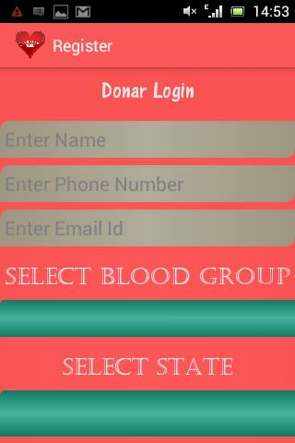
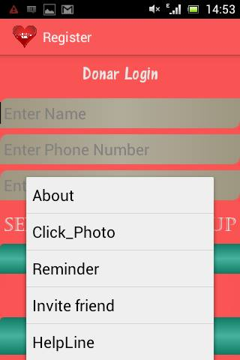
. First screen

Slide 16
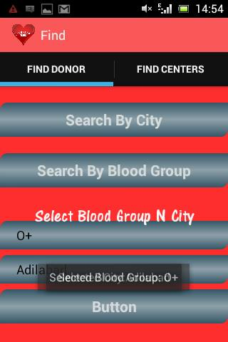
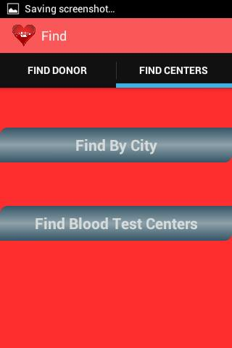
. second screen

Slide 17
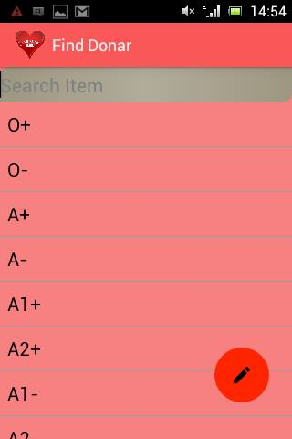
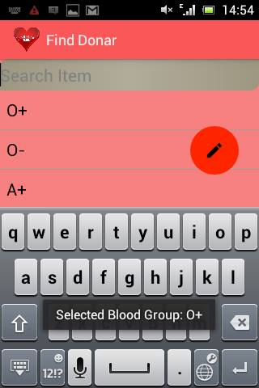

Slide 18
Description: This is the first activity or the first interface that the user will get on his screen when he launches the Blood Donar Application on his Mobile Phone.It will Display the image of the first activity along with logo of our mobile based aaplication. This Activity is made using Splash Screen which actually means is just provides user with interface for a couple of seconds then it moves to another activity on its own.
Splash Activity: Splash screen is generally used when there is a need to do some background process when an
application is initiated. Background process like loading the database, images, making a call over network. These kind of activities will consume time and a splash screen can be shown during that time. A splash screen can be the app icon, company logo and nice welcome image etcetera. Sometimes, splash screens are shown even when there is no need for a background process. This is just to showcase the brand through logo or some image and in this kind of promotional situations it is done based on fixed time interval
Description : This is our second activity which will be launched after Splash Activity terminates.This will be the
Second interface for user where he is required to fill all essential information needed for him to register to this Blood Donation application like:-
His/Her full Name
His/Her Phone Number
His/Her Email Id

Slide 19
Used Method and Elements
Text View-A TextView displays text to the user and optionally allows them to edit it. A TextView is a complete text editor, however the basic class is configured to not allow editing.
Edit Text-A EditText is an overlay over TextView that configures itself to be editable. It is the predefined subclass of TextView that includes rich editing capabilities.
Button- A standard Android button with text on is represented by the Android class android.widget.Button . You can insert a Button instance into your Android app GUI either via a layout XML file or via programmatic insertion. This tutorial will describe both methods
In this the user is required to input some information regarding his Blood Group,Location and Area Code.He is needed to choose his blood group from a list of entities we have set using Spinner.Then he is required to select his Location but pressing Select Location Button which will lead him to yet another activity which will give him list of States along with cities in subview.The last thing he is required to do is Enter his Area Code.
Spinner : Spinners provide a quick way to select one value from a set. In the default state, a spinner shows its currently selected value. Touching the spinner displays a dropdown menu with all other available values, from which the user can select a new one.

Slide 20
List View : Android ListView is a view which groups several items and display them in vertical scrollable list. The list items are automatically inserted to the list using an Adapter that pulls content from a source such as an array or database
Array Adapter : An adapter actually bridges between UI components and the data source that fill data into UI Component. Adapter holds the data and send the data to adapter view, the view can takes the data from adapter view and shows the data on different views like as spinner, list view, grid view etc
button it will show about the application
Click photo
Rimender
Invites friend
Help line

Slide 21
.
THANK
YOU

